Slide 1
EEL
Taweh Browne
Marcus King
David Londono
Gayathri Srinivasan

Slide 2
What does this app do?
Eel was inspired by the popular game Snake. In eel, the theme is modified to resemble underwater features. The theme has changed to present viewers with a new scene instead of a plane white or black background.
In the game an eel is maneuvered by the user to eat a block. The more blocks the eel eats, the longer the eel gets.

Slide 3
Sensor
The sensor we will add in our app will involve using your two fingers to tap the screen. This will add a twist to the game by activating other components such as fish for extra points and sharks for negative points.

Slide 4
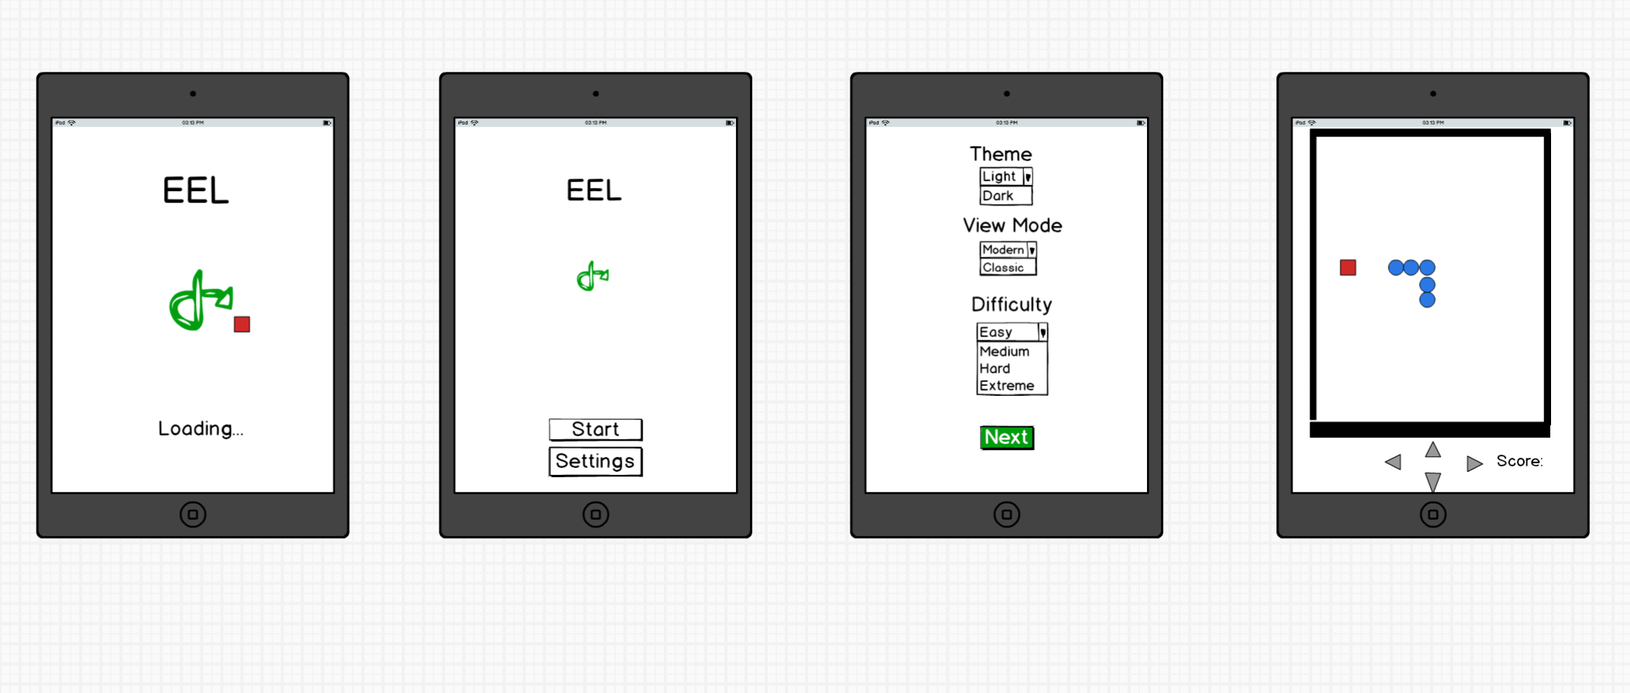
Mockups

